Slide 1

The Crucial Concerns of Ministry
In Defense of Integrity
Week 77
31 January 2024

Slide 2

2 Corinthians Introduction
As we embark upon this study in Second Corinthians, we want to remember that the theme of this letter revolves around both the theological concepts and the practical aspects of Christian living.
The primary issue at Corinth is the recognition of authentic ministry, and submission to apostolic authority. Paul corrective is to provide guidance and encouragement as the church navigates the challenges that continue to influence their unity, discipline, and spiritual growth.
In our study, Paul addresses the Corinthians concerns about his integrity, explaining his change in travel plans, and reassuring the congregation of his genuine concern and love for them.

Slide 3
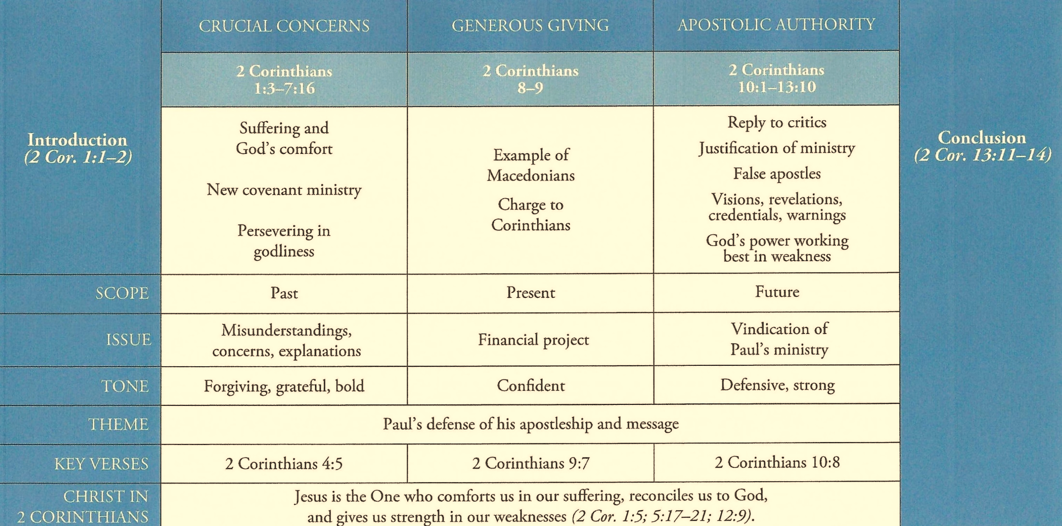
Purpose and Presentation
Second Corinthians
Authentic Ministry

Slide 4

In Defense of Integrity 1:12-2:4

Slide 5
2 Corinthians - Lesson Overview
What is integrity for the Christian?
Honesty and Truthfulness: Being honest in our dealings, truthful in our speech, avoiding deception and falsehoods, and living transparently.
Consistency: We have alignment between what we believe, what we say, and how we act. It fosters trust and credibility in our personal relationships, and in the broader community of faith.
Faithfulness: Keep our promises, honor our agreements, and remain loyal in our devotion to God and others. We are trustworthy stewards of our commitments, responsibilities, and relationships.

Slide 6
2 Corinthians - Lesson Overview
What is integrity for the Christian?
Humility: Acknowledge our limitations, weaknesses, and the need for God’s grace.
Compassion and Justice: Show empathy, love, and justice especially to the marginalized, oppressed, and vulnerable. Stand for what is right and advocate for justice, mercy, and equality.
Forgiveness and Reconciliation: Let go of resentment, embrace forgiveness, seek reconciliation and willingly forgive others, and make amends when necessary.
Holiness: Strive for godliness and moral purity, and seek to live a life that reflects God’s character.

Slide 7
2 Corinthians - Lesson Overview
Swindoll … opens this study by reminding us that everything we do depends on “integrity.” He says, each one of us carries a deadly weapon that can ruin a reputation, annihilate self-esteem, and destroy a person’s dignity.
Its poison causes embarrassment and shame. Though sometimes concealed, when brandished, this weapon can injure everyone in sight, even the one who wields it.
But more often than not, it does its worst damage behind the scenes, cloaked in stealth, stabbing its victims in the back. What is this treacherous weapon?
The Tongue!
Washington Irving once wrote, “A sharp tongue is the only edged tool that grows keener with constant use.”

Slide 8
2 Corinthians - Lesson Overview
In spite of the obvious pain that results from the assassination of ones reputation and character, acts of verbal violence are continually committed in full view for everybody to see!
Somehow our culture tolerates brutal acts of senseless slander as we mercilessly tear each other apart.
Sadly, in the blink of an eye the same tongue can switch from the most soothing salve of sweet syllables to the most venomous verbal poison.
James says this about the double-edge stiletto, “It is a restless evil and full of deadly poison. With it we bless our Lord and Father, and with it we curse men, who have been made in the likeness of God; from the same mouth comes both blessing and cursing” (James 3:8-10).

Slide 9
2 Corinthians - Lesson Overview
Throughout the history of the church, the tongue has been the primary reason for congregational conflict.
When you find a church that has split, chance are if you dissect the dissension, you will find that the tongue provided the fuel that fed the flames of destruction.
Not simply doctrinal disagreement, personality clashes, or differences of ministry vision. Most of the time, we can trace the uncontrollable, volcanic eruptions in our churches back to unrestrained tongues.
Just as James says, “The tongue is a fire, the very world of iniquity; the tongue is set among our members as that which defiles the entire body, and sets on fire the course of our life, and is set on fire by hell” (James 3:6).

Slide 10
2 Corinthians - Lesson Overview
Somehow, politicians survive the booby traps of the campaign trail. Businesses survive the flaming arrows of bad press. Even Hollywood blockbusters and Broadway hits can rake in millions despite scathing reviews.
But whole churches and ministries can be taken down by just one strategically placed rumor. Why?
Because when it comes to Christian ministry, everything depends on the integrity of the messenger.
You can take away my business, my money, and my possessions. But slash at my integrity and you have assaulted the heart of my life.
As children, we often chanted this proverb meant to strength us in the face of ridicule . . .

Slide 11
2 Corinthians - Lesson Overview
“Sticks and stones may break my bones, but words will never hurt.” Words do hurt. Their harmful effects long outlast any physical blow.
Among the many trials we face in our Christian life and ministry, few are more devastating than false statements made against us – especially behind our backs with no opportunity to clear the air or defend ourselves.
Such false assertions can be made 1) against our conduct – things we did not do; 2) against our words – things we did not say; or 3) against our motives – things we did not mean.
Paul was the victim of all three kind of attacks from false teachers, seeking to malign his integrity and alienate the Corinthians from the ministry of their founding apostle.

Slide 12
2 Corinthians 1:12-14
¹² For our boasting is this: the testimony of our conscience that we conducted ourselves in the world in simplicity and godly sincerity, not with fleshly wisdom but by the grace of God, and more abundantly toward you. ¹³ For we are not writing any other things to you than what you read or understand. Now I trust you will understand, even to the end ¹⁴ (as also you have understood us in part), that we are your boast as you also are ours, in the day of the Lord Jesus.

Slide 13
2 Corinthians 1:12-14
The confused church in Corinth may not have fully realized how hurtful they had been to Paul, who had poured his energy into their conversion and spiritual growth.
Writing letters, sending delegates, leaving teachers, and traveling there himself to exhort and strengthen the church – no other church in the New Testament had caused Paul as much grief or took as much of his time and energy.
So, following his treatise (1:3-11) on the reasons for suffering, Paul immediately transitions to a defense of his true character in response to harmful false accusation.
It appears that questions, about Paul’s conduct and sincerity were the cause of this conflict between him and the church in Corinth.

Slide 14
2 Corinthians 1:12-14
So, with directness and clarity, Paul refutes the charges: “In holiness and godly sincerity, not in fleshly wisdom but in the grace of God, we have conducted ourselves in the world, and especially toward you” (1:12).
For Paul to point to the consistent holiness and sincerity of himself and those working with him as his defense, means he was confident that nobody in Corinth would have been able to refute him.
In fact, he was able to exhibit “proud confidence” in their unimpeachable conduct. Paul merely reminded them of their irreproachable lifestyle; he did not have to convince them of it.

Slide 15
2 Corinthians 1:12-14
Paul hoped that the words of this latest letter would pierce through the misconceptions or deceptions that had been clouding their understanding, so that they would see thing clearly (1:13).
Paul hoped his words would dispel the seeds of distrust that had been planted by his opponents and that one day they would take as much pride in him and his ministry as he took in them and their conversion (1:14).

Slide 16
2 Corinthians 1:15-22
¹⁵ And in this confidence I intended to come to you before, that you might have a second benefit— ¹⁶ to pass by way of you to Macedonia, to come again from Macedonia to you, and be helped by you on my way to Judea. ¹⁷ Therefore, when I was planning this, did I do it lightly? Or the things I plan, do I plan according to the flesh, that with me there should be Yes, Yes, and No, No? ¹⁸ But as God is faithful, our word to you was not Yes and No. ¹⁹ For the Son of God, Jesus Christ, who was preached among you by us—by me, Silvanus, and Timothy — was not Yes and No, but in Him was Yes. ²⁰ For all the promises of God in Him are Yes, and in Him Amen, to the glory of God through us. ²¹ Now He who establishes us with you in Christ and has anointed us is God, ²² who also has sealed us and given us the Spirit in our hearts as a guarantee.

Slide 17
2 Corinthians 1:15-22
The blatantly false accusations of improper carnal conduct, were relatively easy for Paul to overcome. By simply reminding his readers of the blameless conduct exhibited among them – principles matched by his writings.
However, a more sinister verbal cancer was spreading, and it apparently (though not real) had supporting evidence.
Some were saying that Paul made promises he did not keep, that he said one thing and did another, that he was guilty of fickle vacillation and could not be trusted.
These allegations were persuasive because Paul had hoped to visit the Corinthians for a lengthy period of time but had not been able to come.

Slide 18
2 Corinthians 1:15-22
This accusation was based on Paul’s expressed desire in 1Cor. 16:5-7 to visit, which ended with “if the Lord permits.”
Nowhere did Paul promise to come according to a specific timetable, and in the sovereignty of God, things didn’t turn out as he had hoped.
Paul admits, in 1:15-16, that he had planned on visiting the Corinthians twice during his trip to and from Macedonia. Evidently, they mistook Paul’s intentions for a firm promise.
So when he did not show up as hoped, they concluded, “If we can’t trust Paul to keep a simple promise, how can we trust him to communicate to us the promises of God?” No doubt these charges were echoed by Paul’s critics, who were eager to find ways to tear down his credibility to build up their own.

Slide 19
2 Corinthians 1:15-22
Paul counters with three rapid-fire questions, which in the original Greek expected negative answers (1:17).
He wasn’t vacillating in his intentions.
He didn’t make plans according to the flesh.
He didn’t say yes and no at the same time.
As Christians, our word ought to be our bond. When we say we will do something, we should do it. We should not require signed contracts, handshakes, or “pinky swears.”
When we say yes, it ought to mean yes. And if we can’t follow through because of something beyond our control, we need to explain, apologize, and satisfy our obligation in some other way.

Slide 20
2 Corinthians 1:15-22
The apostle Paul was smart enough not to promise that he would visit the Corinthians.
But that … He had hoped. He had yearned. He had intended. And this he planned in the presence of God while submitting to God will. Nonetheless, he had not set forth a hard-and-fast promise.
Paul’s situation here provides us with an important piece of advice:
Be careful about making promises you are not sure you will be able to keep.
In other words, it is better to keep things undecided or up in the air than to promise and later disappoint.

Slide 21
2 Corinthians 1:15-22
So, to clear up any confusion, Paul makes a distinction between his uncertain plans, and the authoritative, always trustworthy and unalterable word of God spoken by the apostles (1:18-22).
Although, his tentative plans – submitted to the will of God – did not always turn out as intended (1:15-16). The plans of God always reach the goal God intends.
While the promises of God were set in stone and are irrevocable, the Corinthians should have held Paul’s plans as tentative, subject entirely to the will of God.
Instead they misunderstood his intentions as a promise, an error that opened the door to the unfounded charge of fickle vacillation.

Slide 22
2 Corinthians 1:23-2:4
²³ Moreover, I call God as witness against my soul, that to spare you I came no more to Corinth. ²⁴ Not that we have dominion over your faith, but are fellow workers for your joy; for by faith you stand. 2 But I determined this within myself that I would not come again to you in sorrow. ² For if I make you sorrowful, then who is he who makes me glad but the one who is made sorrowful by me? ³ And I wrote this very thing to you, lest, when I came, I should have sorrow over those from whom I ought to have joy, having confidence in you all that my joy is the joy of you all. ⁴ For out of much affliction and anguish of heart I wrote to you, with many tears, not that you should be grieved, but that you might know the love which I have so abundantly for you.

Slide 23
2 Corinthians 1:23-2:4
Now, Paul moves from clarifying that his plans and intentions were not the same as God’s promises, to a brief explanation of why he did not travel to Corinth as he had originally hoped.
The fault, he says, was not his but theirs. He delayed his journey in order to spare them a painful visit that would have cast a dark shadow on what should have been a joyous reunion (1:23; 2:1-2).
Because the Corinthians response to the first letter, that dealt with the schisms, insubordination, and their tolerance for immorality, had only been partly received. Pockets of resistance still remained.

Slide 24
2 Corinthians 1:23-2:4
After receiving news that the church still had not fully repented of their disorder and disobedience, Paul wrote another letter following up on the incestuous relationship he had denounced in the first letter (1Cor. 5:1-8).
Paul wanted to wait for their reaction to that letter rather than arrive on its heels as if he were reinforcing his mandates with a personal visit to “crack heads” like a harsh and vengeful taskmaster.
His desire was to wait until the matter was resolved and the church was restored to love, joy, and peace. His words are those of a loving shepherd, not an angry, self-serving tyrant.
We can infer, from 1:24, that some in Corinth were also charging Paul with wanting to throw his spiritual weight around as a dictator lording it over their faith.

Slide 25
2 Corinthians 1:23-2:4
Paul had to remind the Corinthians that even as an apostle, his role was one of fellow worker (1:24), and as servant (4:5).
While true servanthood is a rare quality today, our problem is a simple, yet sad one. There are so few examples of it. Leaders in the church often lord their position over the flock.
But Paul followed the pattern of Christ’s self-sacrificial leadership (Mark 10:45), and approached his apostolic role as a shepherd to be loved and respected, not as a tyrant to be feared and worshiped.
The accusations against Paul were either flat-out false, exaggerations, or simple misunderstandings.

Slide 26
2 Corinthians 1:23-2:4
Yet, in the hands of his adversaries, the rumor mill used these accusations to try to grind his reputation to a pulp.
They accused him of carnal conduct (1:12-14); he responded with facts.
They accused him of fickle vacillation (1:15-22); he responded with clarification.
They accused him of domineering dictatorship; he responded with cool constraint.
Paul’s critics targeted his conduct, words, and motives; he responded with facts, clarification, and constraint.
What admirable wisdom and restraint!

Slide 27
Applications
Of the
lesson
Time To Take A Stand

Slide 28
Application – time to take a stand
In closing Swindoll says … Most of us respond to false accusations in one of two ways.
We either bite our tongues, hoping the matter will blow over, or we explode in rage with our own exaggerated accusations.
While both responses are understandable, neither is profitable. Why?
The first response leaves the lie unanswered, and the smoldering coals of damaging scandal does not quickly burn themselves out.
At any moment they can flare up and explode into open controversy. Those fiery lies must be doused with a flood of truth.

Slide 29
Application – time to take a stand
The second response only compounds the problem, fanning the flames of slander and spreading the fires of falsehood far and wide.
The apostle shows us a better way to respond to the hurtful false accusation of the opposition: firmly, calmly, and armed with truth. These three principles will help us handle false accusations:
FIRST – Sometimes defending one’s integrity calls for strong action.
1) Go directly the accuser (Matt 18:15).
Don’t go to other people ahead of time or afterward to “get advise” or “gather prayer support.” Those are often code words for “gossip” or “slander.”

Slide 30
Application – time to take a stand
Go directly to the accuser, as Paul went directly to the Corinthians; first by letter, then eventually in person.
2) Stay completely with the facts.
Stay away from emotions, from sarcasm, and from the temptation to exact revenge. Stick with the “who, what, where, when and why.”
3) Speak openly, firmly, and lovingly.
There are times when you must defend your integrity with an accuser, but this should never be and occasion to forsake your integrity as a Christian witness.
SECOND – There are times when the best response is silence. In a few cases, absolute, sustained silence may be the best defense.

Slide 31
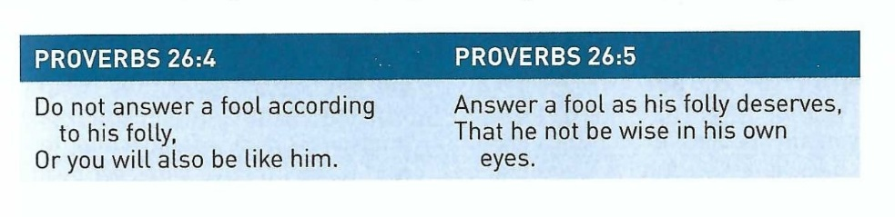
Application – time to take a stand
For example, if you do not know who your accuser is, it is probably best to wait in silence. Or if the accuser is unavailable or inaccessible, back off and be still.
At times the more you defend yourself the more you appear guilty. Sometimes you should hold your peace. So, how do we know when to speak up or when to be silent?
The answer is wisdom.
The wisest way to respond to a fool is determined on a case-by-case basis. Sometimes it’s wise to answer; sometimes it wise to be silent.

Slide 32
Application – time to take a stand
We need to call on God for the wisdom to navigate these situations (Jas. 1:5). Ask God for vindication, and then let Him fight your battle (Ps. 26).
THIRD – Whether with assertiveness or silence, never take revenge. Whichever approach you use, leave the payback out of it. Listen to Paul’s advise to the Roman church: “Do not avenge yourselves, but rather give place to wrath; for it is written “Vengeance is Mine, I will repay,” says the Lord” (12:19).
If justice is to be meted out, God is perfectly capable, and willing, to do that. So, when we don’t see God handling our problems, it is likely that we fail to give Him the opportunity to do so.
Step out of the way and let God fight for you!

Slide 33


“In Defense Of Integrity”

Slide 34
NEXT CLASS – 07 February 2024
Book of Second Corinthians
Before next class, read the below chapters in the NKJV and in one other versions of the Bible, i.e., KJV, NRSV, NIV, CEV, etc …
Chapter 2:5 – 11
“Confusing Pardon with Probation”

